Slide 1
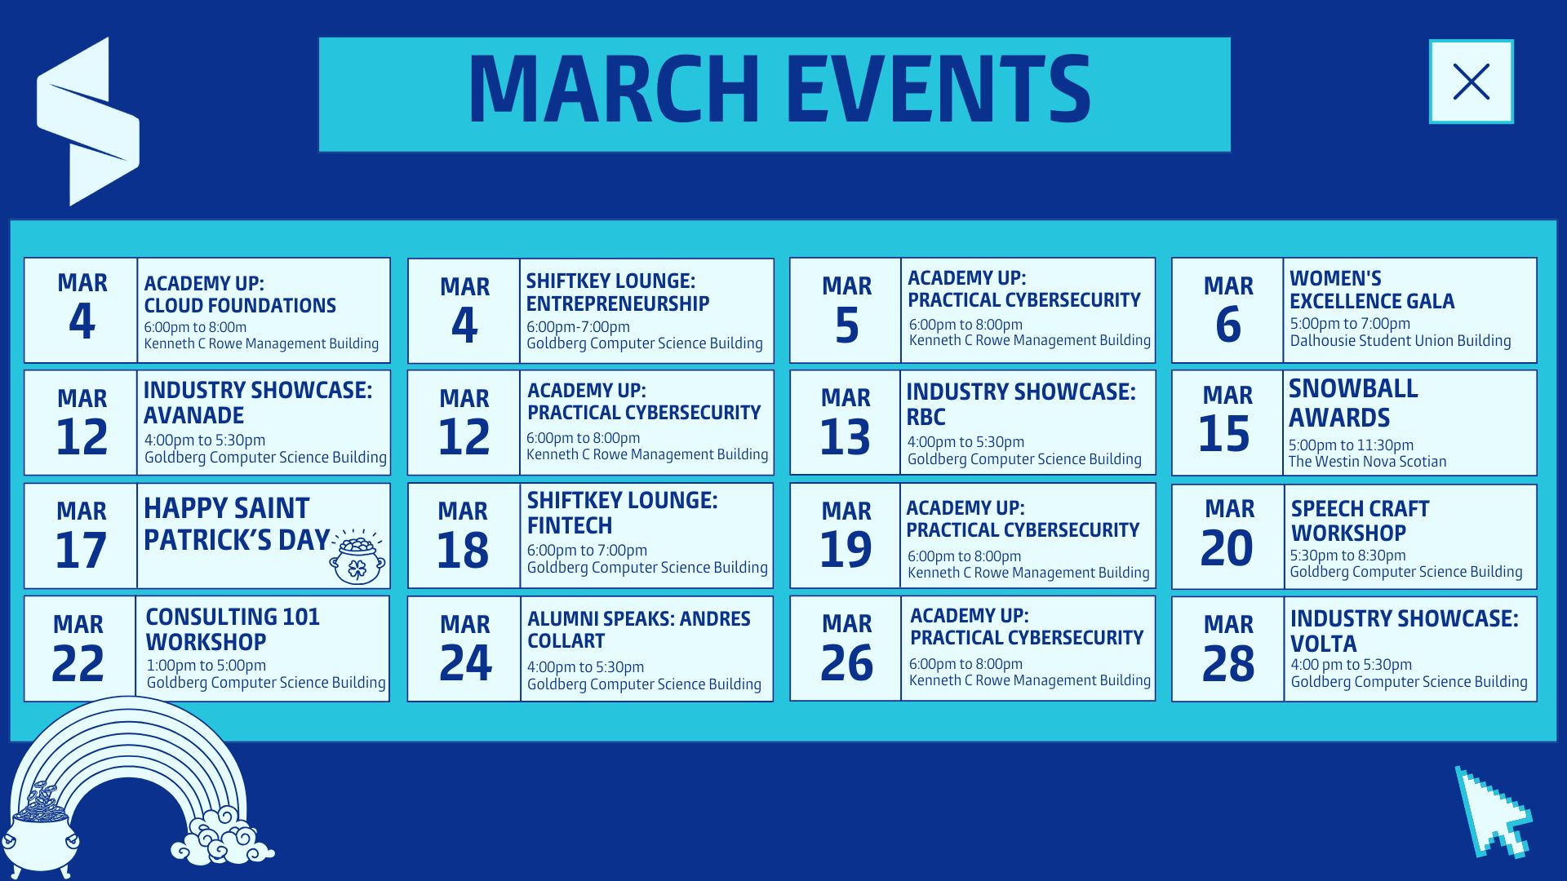

Slide 2

Instructor: Aman Bhalla

Slide 3

Learning Objectives
By the end of this session, you will:
Understand network security principles (firewalls, IDS/IPS, VPNs).
Differentiate between encryption methods (symmetric vs. asymmetric).
Learn best practices for authentication & secure communication.
Analyze encrypted vs. unencrypted network traffic using online tools.

Slide 4

What is Network Security?
Definition: Network security is the practice of protecting data, devices, and systems from cyber threats by controlling access and monitoring network activity.
Prevents unauthorized access to sensitive data.
Ensures data integrity (no tampering).
Maintains availability (systems stay online).
Example:
A remote data centre without security cameras or alarms. Network security is the digital equivalent—without it, attackers can easily steal or manipulate data.

Slide 5
Key Network Security Components
1. Firewalls – Act as digital barriers between networks.
2. Intrusion Detection/Prevention Systems (IDS/IPS) – Detect & block malicious activities.
3. Virtual Private Networks (VPNs) – Encrypt internet traffic for secure remote access.
4. Secure Communication Protocols (HTTPS, SSL/TLS) – Protects data in transit.

Slide 6
Firewalls – The First Line of Defense
Definition: A firewall is a security system that monitors and controls incoming and outgoing network traffic based on security rules.
Blocks unauthorized access while allowing legitimate communication.
Can be hardware, software-based or cloud-based.
Protects against malware, hackers, and phishing attacks.

Slide 7
IDS vs. IPS
What’s the Difference?
IDS (Intrusion Detection System): Monitors & Alerts – Detects suspicious activity but does not block it.
IPS (Intrusion Prevention System): Monitors & Blocks – Detects and automatically stops threats.
How They Work:
IDS: Passive – Logs threats, alerts security teams.
IPS: Active – Blocks malicious traffic in real time.
Example:
IDS: Notifies about a hacker scanning the network.
IPS: Detects & blocks the hacker’s attempt instantly.
Which One is Better?
IDS = Great for monitoring & analysis.
IPS = Better for real-time attack prevention.
Best practice? Use both for layered security.
Discussion: Would you rather detect or prevent threats? Why?

Slide 8
Encryption & Data Security
Definition: Encryption converts readable data (plaintext) into an unreadable format (ciphertext) to prevent unauthorized access.
Types of Encryption:
Symmetric Encryption – Uses the same key for encryption & decryption (e.g., AES).
Asymmetric Encryption – Uses a public key for encryption and a private key for decryption (e.g., RSA).

Slide 9
Introduction to VPNs – What & Why?
What is a VPN?
A Virtual Private Network (VPN) encrypts internet traffic, making it unreadable to hackers.
It creates a secure “tunnel” between your device and the internet.
Hides your IP address, keeping your online activity private.
Why Use a VPN?
Protects data on public Wi-Fi – Prevents hackers from stealing your information.
Hides your online identity – Websites and advertisers can’t track your real location.
Encrypts your internet traffic – Even if intercepted, data is unreadable.
Example:
Logging into your bank account on public Wi-Fi without a VPN can expose your credentials.

Slide 10
How VPNs Work & When to Use One
How Does a VPN Work?
Encrypts your internet traffic so hackers can’t see what you’re doing.
Routes your connection through a secure VPN server before reaching the internet.
Changes your IP address to protect your location and identity.
When Should You Use a VPN?
On Public Wi-Fi (cafés, airports, hotels).
When Accessing Sensitive Accounts (banking, work emails).
When Bypassing Geo-Blocked Content (e.g., restricted websites).
VPN Limitations:
VPNs don’t protect against malware or phishing attacks.
Some free VPNs log and sell your data – use trusted providers!
VPNs can slow down your internet speed due to encryption.

Slide 11
Secure Communication Protocols (HTTPS, SSL/TLS)
HTTPS (Hypertext Transfer Protocol Secure): Ensures data exchanged between a browser and website remains encrypted.
SSL/TLS (Secure Sockets Layer/Transport Layer Security): Encrypts data during online transactions.
Example: Websites with a 🔒 lock symbol use HTTPS, protecting login credentials from being stolen.

Slide 12

Team Activity – Build A Secure Network

Slide 13
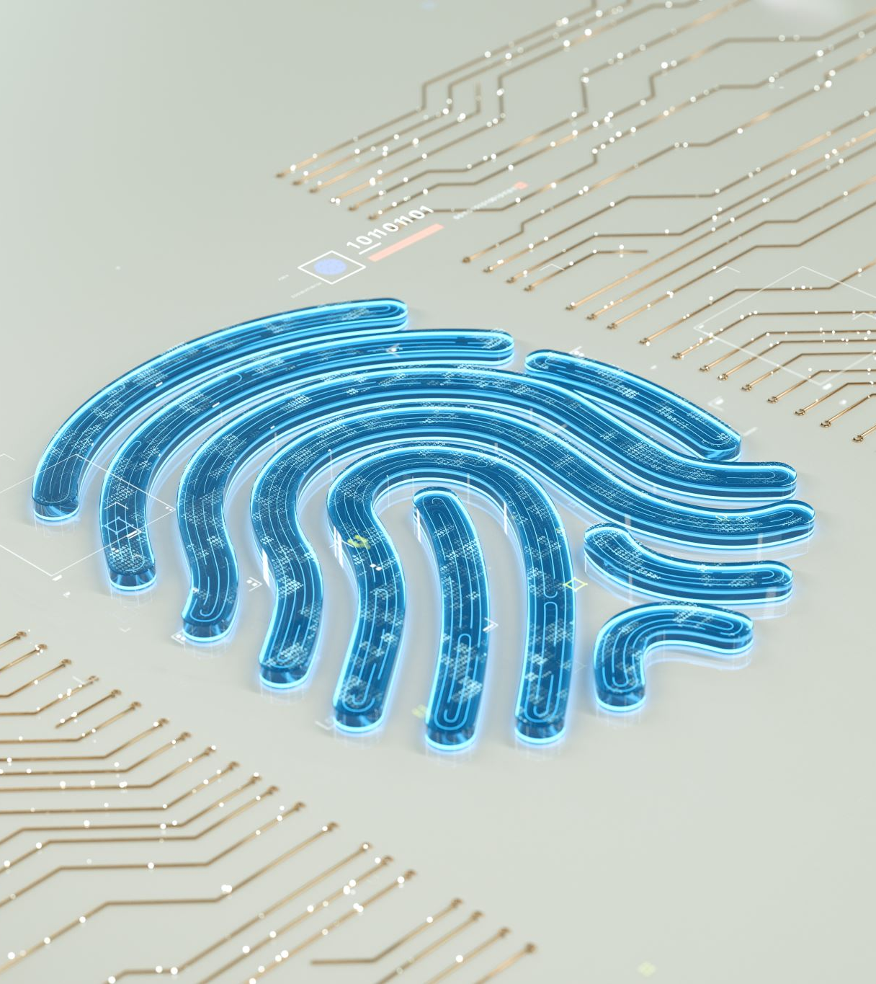
Authentication & Multi-Factor Authentication (MFA)
Definition: Authentication ensures only authorized users can access a system.
Single-Factor Authentication (SFA): Password-only login (least secure).
Multi-Factor Authentication (MFA): Requires an extra security step (e.g., phone code).
Biometric Authentication: Uses fingerprints or facial recognition.

Slide 14

Practical Activity – Encryption & Network Traffic Analysis
Activity 1: Encryption & Hashing
CyberChef link: https://gchq.github.io/CyberChef/
Activity 2: Analyzing Encrypted vs. Unencrypted Network Traffic
Packet capture viewer link: https://apackets.com
Tool for testing : https://www.wireshark.org/#downloadLink

Slide 15
Q&A & Discussion
Do you use Multi-Factor Authentication (MFA)? Why or why not?
What happens if an attacker steals unencrypted data?
What was the most interesting aspect of Network Security to you? Why?

Slide 16

Key Takeaways
Firewalls & IDS/IPS protect networks from cyber threats.
Encryption ensures data security, both in transit & at rest.
MFA and strong authentication prevent unauthorized access.

Slide 17

Week 3 Preview
Secure Software Development & OWASP Top 10
Incident Response & Threat Intelligence
Practical Activity: Web Application Scanning with OWASP ZAP

Slide 18

Quiz Time!
Time Limit – 15 Minutes. Quiz begins at 7:45 pm and will close at 8:00 pm.
Questions: MCQ’s, True or False and Short Answer.

